Slide 1
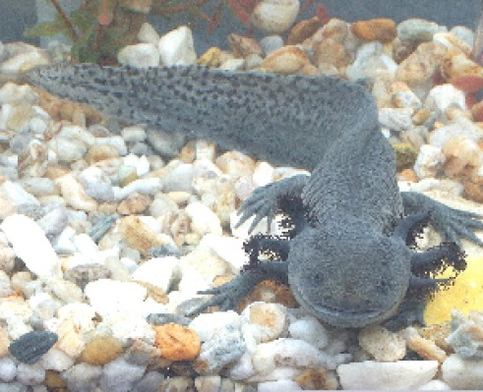
Presenting Evidence of Success

Slide 2
Means of Verification
Identified sources of evidence you will use to verify your projects success
How outputs and achievements are measured
Projects expected to submit these means of verification with your annual report and final report

Slide 3
Types of material that can be used
Generated by project
External to project
Project deliverables i.e.
Peer review papers & citations
Workshop proceedings
Survey reports
Photos
Videos
Website hits/ downloads
Government data
Committee meeting minutes
Independent produced reports
Red list reports
CITES reports
CBD reports
CMS reports

Slide 4
Key points
Material produced by external sources is a stronger source of evidence than project produced materials
However – control over timing of release of these materials is harder to predict
A mix is suggested
You may need to offer multiple means of verification for one indicator

Slide 5
Using your evidence to promote your success
The Darwin Initiative reports should not be your only audience when promoting the success of your project- there are many ways of promoting your project and the Darwin Initiative
Consider:
Who is your audience?
In what format do they use/read/digest evidence?
When could you best present your material (leverage)?
What language should you use (technical vs. layman)

