Slide 1
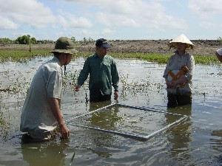
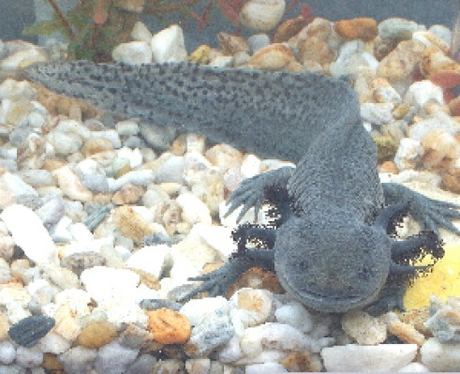
The Darwin Initiative
Workshop for Stage 2 projects

Slide 2
Objective of the Day
To meet the Darwin Initiative key people and understand their role
To better understand DFID requirements and ways to improve applications
To meet other Darwin project staff and build links between projects

Slide 3
Agenda - Afternoon
Evaluating Impact and Measuring Success
- Setting your objectives
Measuring impact vs. activity
SMART indicators
Presenting evidence
Developing an M&E plan

Slide 4
Introductions
Introduce yourself and your project:
Name
Institution
Project
Focus
History with Darwin?

