Slide 1
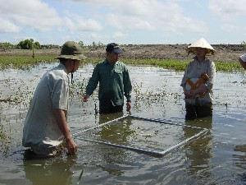
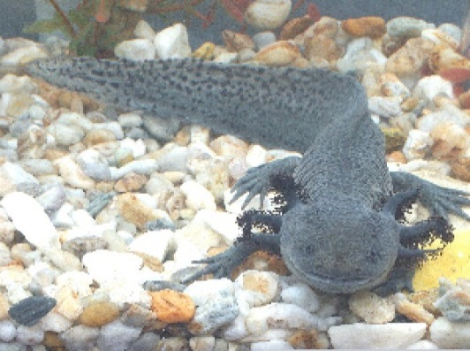
The Darwin Initiative Workshop for New Projects
Sally Cunningham
Defra
Sally Cunningham
Defra

Slide 2
Welcome & congratulations
Round 21 – just completed
357 main project applications received at Stage 1
57 main project applications invited to Stage 2
19 new main projects funded
43 applications for Darwin Plus
11 new Darwin Plus projects funded
2 scoping projects funded
4 Darwin Fellowships funded
2 Post projects funded

Slide 3
Evolution of the Darwin Initiative
Launched in 1992 at the Rio Earth Summit
Aim to help developing countries implement CBD
2003 - introduced post-projects, scoping awards and fellowships.
2008 widened scope to include CITES and CMS
Since 2010 - focus on development and poverty alleviation
2013 – focus on illegal wildlife trade
2014 – focus on ABS and the Plant Treaty

Slide 4
Darwin and the UK OTs
2009 – Darwin funding ring-fenced for projects in the UK OTs
Challenge Fund established (to scope out main round applications)
2012 - Darwin Plus Fund established
Dedicated fund for environment projects in the OTs
co-funded by Defra, DFID and FCO
To date has funded 40 projects totalling £5.2m

Slide 5
Snapshot of Darwin’s success
Over £113 m invested since 1992 in 943 projects working in 159 countries
Over 2,300 species or habitat management plans
Over 2,400 peer review papers
Around 1,300 species reference collections
Around £5m value of physical assets handed over to host country(s)
Over £56m resources leveraged as a result of Darwin projects

Slide 6
The Future of Darwin
Defra remains committed to the Darwin Initiative
Recognising the strength of Darwin, this support is now supplemented by commitment from DFID.
Next round of funding expected Summer 2015 (later due to the General Election).

Slide 7
Darwin ‘Family’
Darwin Secretariat (Defra)
Darwin Expert Committee (DEC)
Darwin Plus Advisory Group (DPAG)
LTS International (Darwin Administrators)
Darwin projects

Slide 8
Who’s Who in Darwin?
LTS International
Darwin Secretariat
Darwin Projects

Slide 9
Darwin Initiative Secretariat – our roles
Clare Hamilton – overall management /strategy of the Darwin Initiative
Sally Cunningham – Management of the Darwin
administration contract, policy adviser
Paula Hendy – Financial administration (payment of claims).

Slide 10
What the Darwin Secretariat do…
Overall management and strategy of Darwin Initiative
Ministerial advice (PQs, correspondence, briefings)
Management of the Darwin and M&E contract
Support to the DEC and DPAG
DEC appointments
Publicity and events

Slide 11
Darwin Publicity and Events
Website
Newsletter
Twitter account
Facebook page
You Tube channel
LinkedIn
Flickr photos
Blog (new)

Slide 12
Darwin events
For projects:
New Project Leaders workshop
Applicants workshop
For all:
Side events at international meetings
Media events

Slide 13
Publicising your Darwin project
Keep us informed of progress
Please mention the Darwin Initiative!
Maintaining a high profile for the Darwin Initiative helps maintain Government funding
Contact LTS and/or Defra for further info

Slide 14
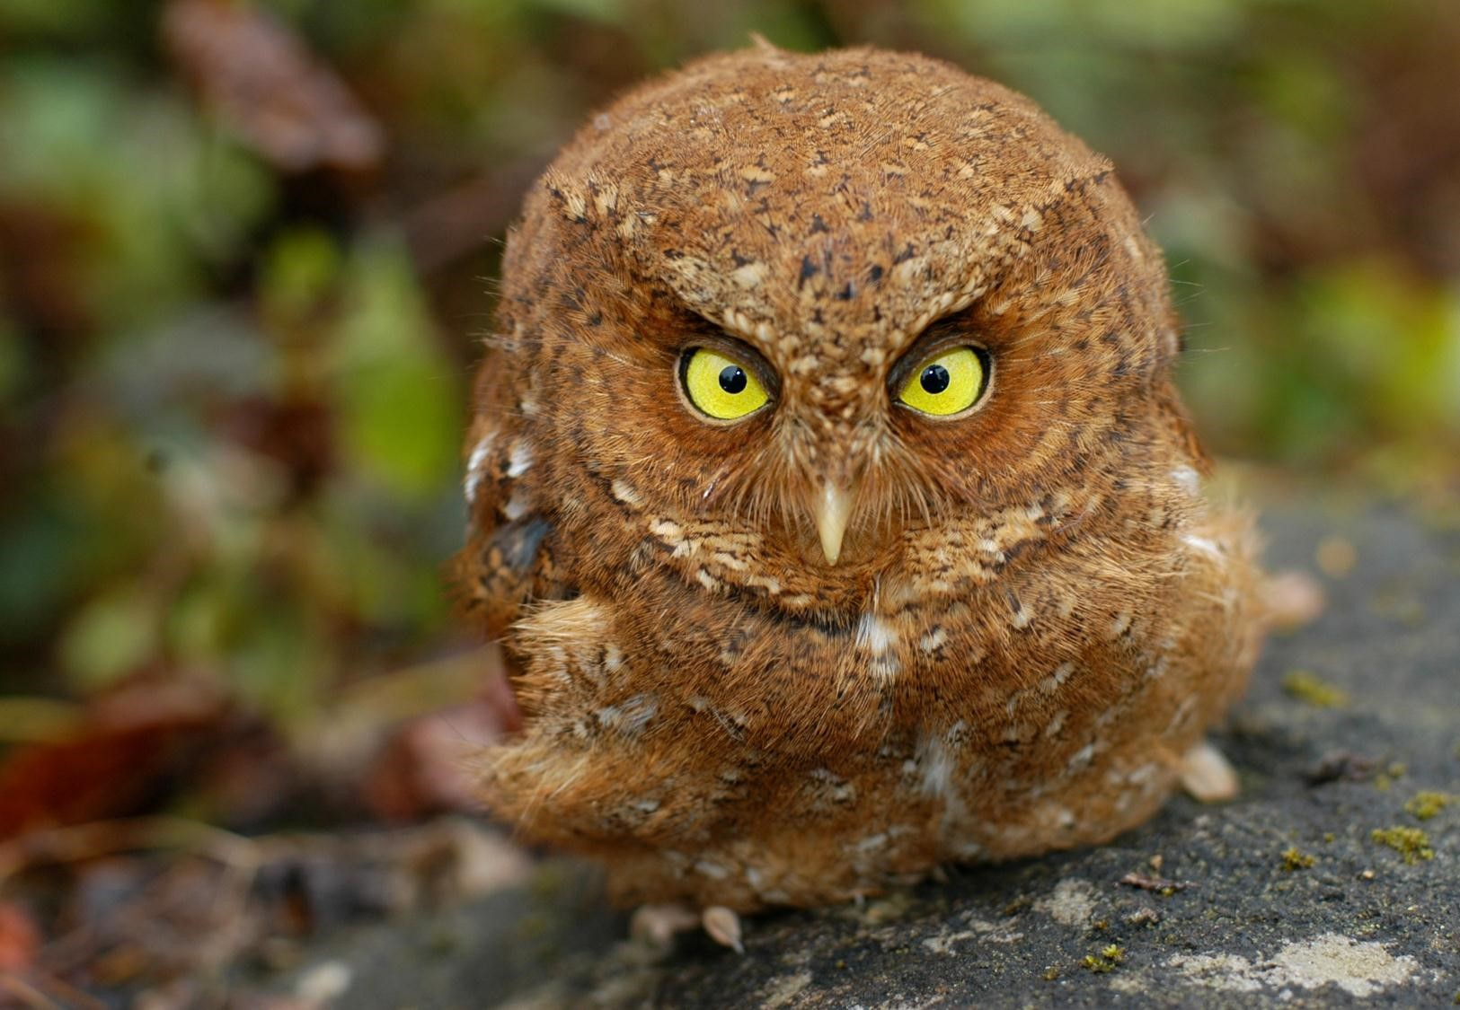
Any questions?

